Slide 1


Video Games Analytics
Dylan, Sarah, & Lizzy
Team High Five

Slide 2

Introduction
This dataset is all about the Video Games that were released from 2004-2008.
The data features lots of information from the title of every game to the average playtime of each title.
The data is from CORGIS, and was Originally collected by Dr. Joe Cox at University of Portsmouth.
Notes:
Explain why we picked this data

Slide 3

Data Cleaning
The CORGIS version was pre-cleaned
We had to rename most columns for SQL
We had to delete lots of extra/incomplete data
The dataset ended up with half of the original columns
Length.AllPlayStyles.Average
Average Length
Notes:
Remember to explain the pictures

Slide 4
Initial Research Questions
1. What game takes the longest to play through?
2. How many games did Sony release in 06?
3. How many Call of Duty titles were released in the time frame?
4. How many games were rated E, M, or T in the time frame?
5. Which console has the most games based on the dataset?
Monster Hunter Freedom
14
6
E = 491, M =251, T =470
Nintendo DS
Notes:
Remember to explain what E,M, and T stands for

Slide 5
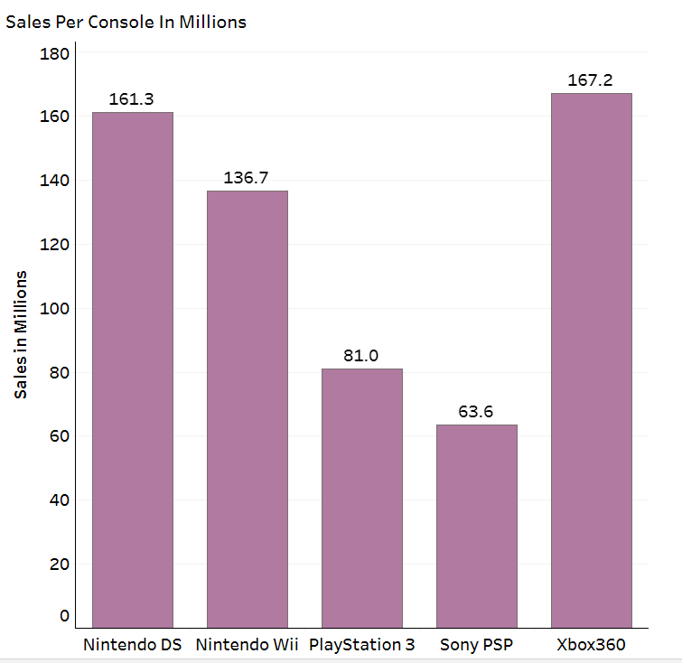
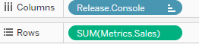
How many sales did each console make?
Our answer:
How we got there:
The console that had the most sales overall was the Xbox 360
Made in Tableau
Notes:
Explain each step we took to get to what the graph shows

Slide 6

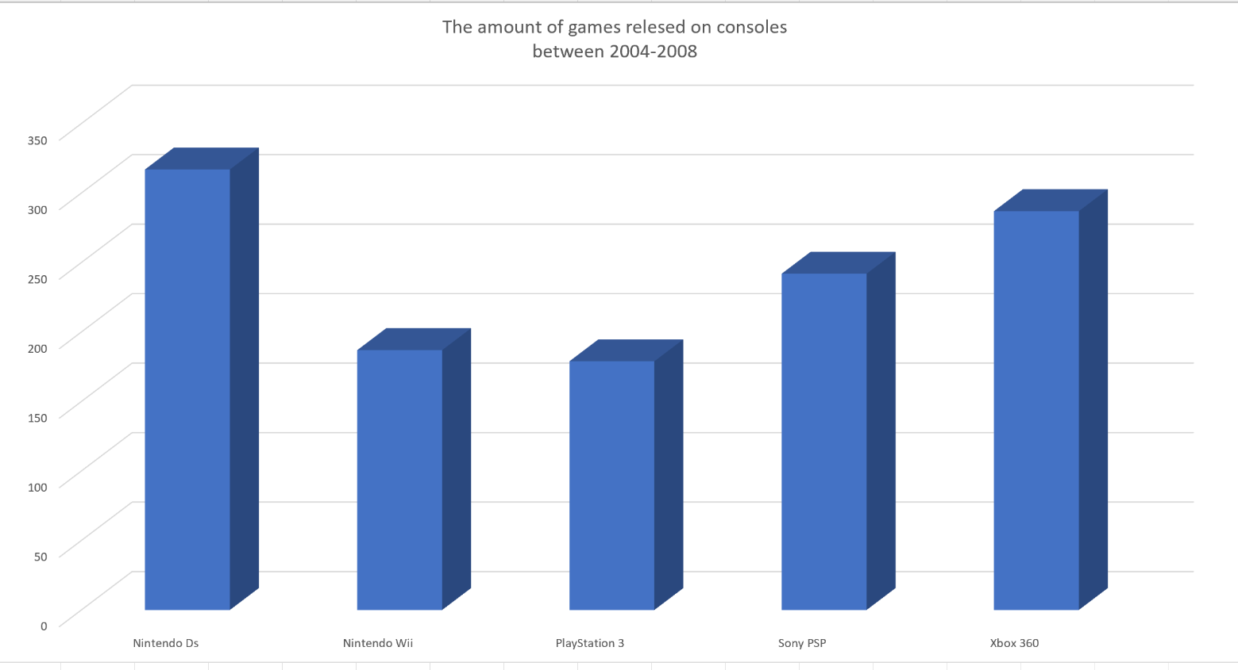
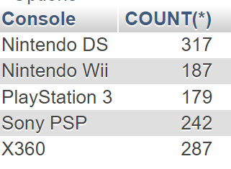
Which console has the most games?
Our answer: Nintendo DS
How we got there:
The Number of Games Released on Consoles Between 2004-2008
SELECT `Console`,
COUNT(*)
FROM `Video Games`
Group BY `Console`
Nintendo DS
Nintendo Wii
PlayStation 3
Sony PSP
XBOX 360
Made with Excel

Slide 7
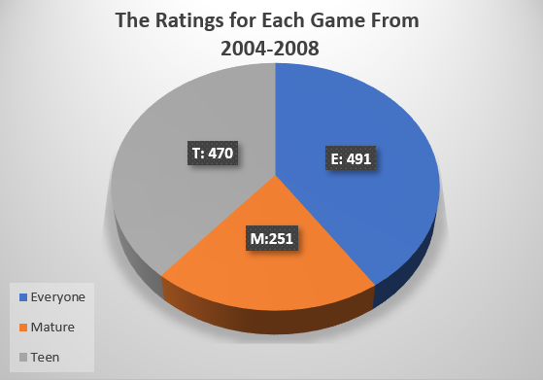
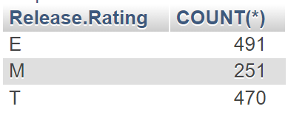
What are the ratings of each game?
Our answer:
How we got there:
SELECT `Release.Rating`,
COUNT(*)
FROM `Video Games`
Group BY `Release.Rating`
Made with Excel

Slide 8


.
Conclusion
What we learned:
Not all data in a dataset is useful data.
Nintendo has had a lot of success and influence over the industry in the early 2000’s
Challenges:
Trying to read our data. (We overcame that by data cleaning.)
Trying to get questions to work for our data. (We overcome this by making better understanding questions.)
What we would do next time:
We would grab data that is more relevant and covers a wider range of time
A question we could not Answer:
The amount of genres from each title. (This was due to them being mixed together in the data set)
Notes:
Try to explain how we overcame the problems when you’re presenting, so we don’t have to keep that on the slide
Check for spelling errors

Slide 9


That is All

